Slide 1
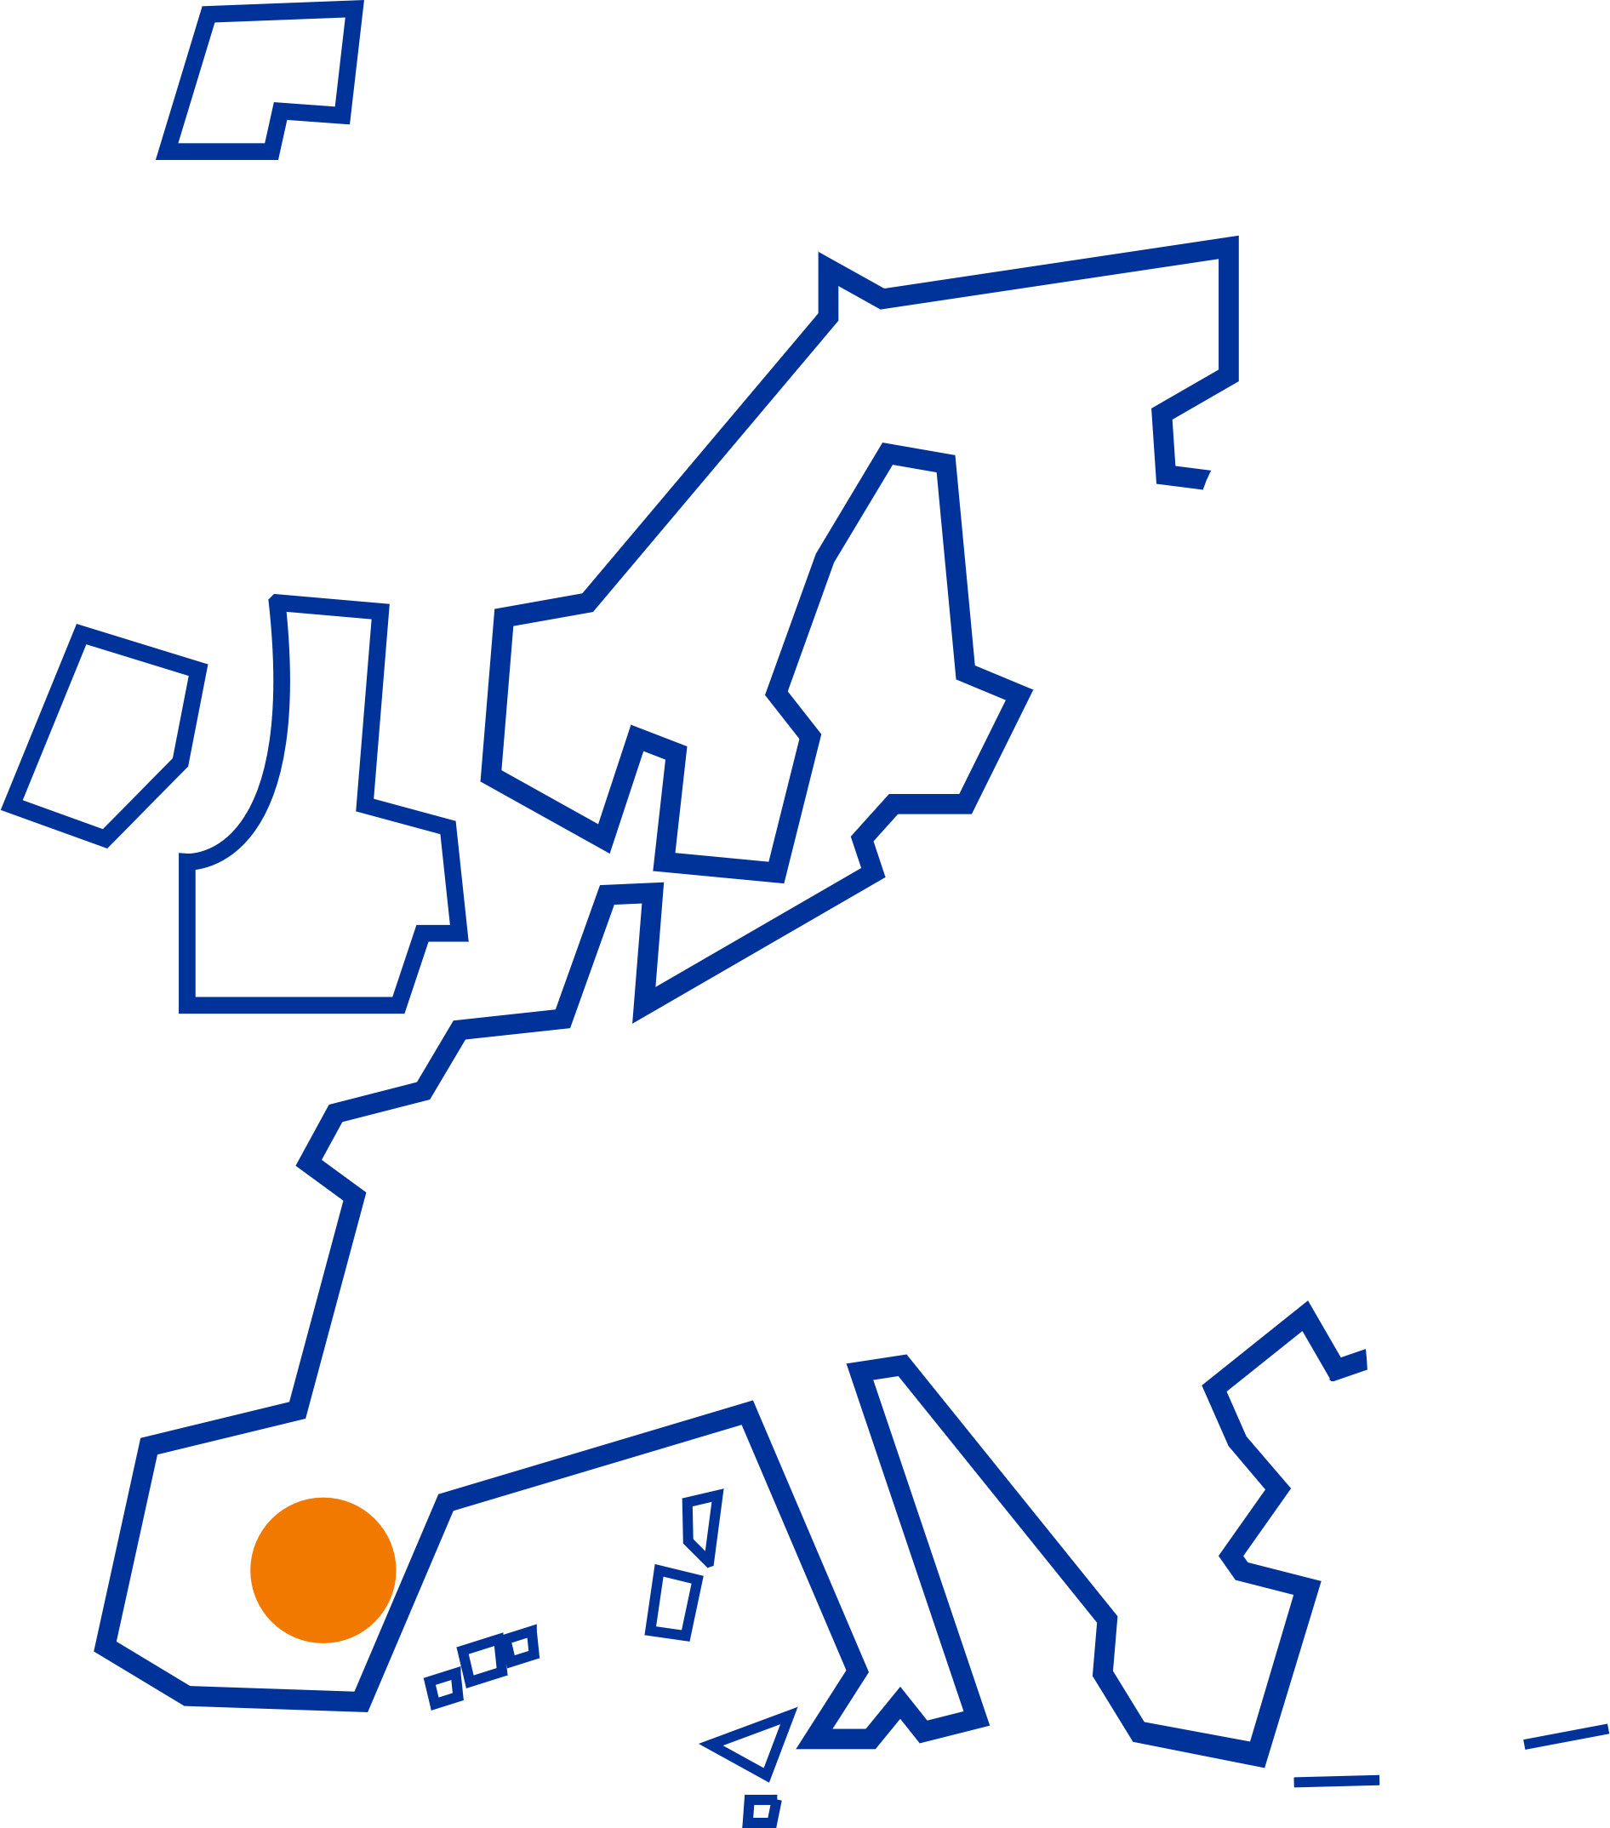
ESPON Seminar Small and medium-sized cities in Europe
15-16 November 2023 in Cuenca, Spain
Italian experience of inner areas in Lombardia Region
Matteo Bianchi. ANCI Lombardia

Slide 2
1
The Regional Strategy for Inner Areas:
«Counter-Exodus Agenda»
Inner areas and ANCI Lombardia:
a strategy for local development
Inner areas as a laboratory for local governance
Italian experience of inner areas in Lombardia Region
2
3

Slide 3
The Regional Strategy for Inner Areas: «Counter-Exodus Agenda»
1
Matteo Bianchi – ANCI Lombardia
16 November 2023

Slide 4
The Regional Strategy for Inner Areas: «Counter-Exodus Agenda»
With the DGR XI/5587 Lombardy Region adopted a regional Strategy for inner areas: the Counter-exodus Agenda.
The regional Strategy aims to ‘’build a system in which all territories have equal access and opportunities for development’’ and states that the fundamental elements for territorial attractiveness are “solid social cohesion, an adequate network of basic services (starting with social and health services), and an adequate offer of cultural, artistic, sporting and recreational proposals”.
IN NUMBERS:
14 Inner areas
6 national Inner areas
8 regional Inner areas
488 Municipalities
19 Mountain comunities
>1mln. inhabitants
Matteo Bianchi – ANCI Lombardia

Slide 5
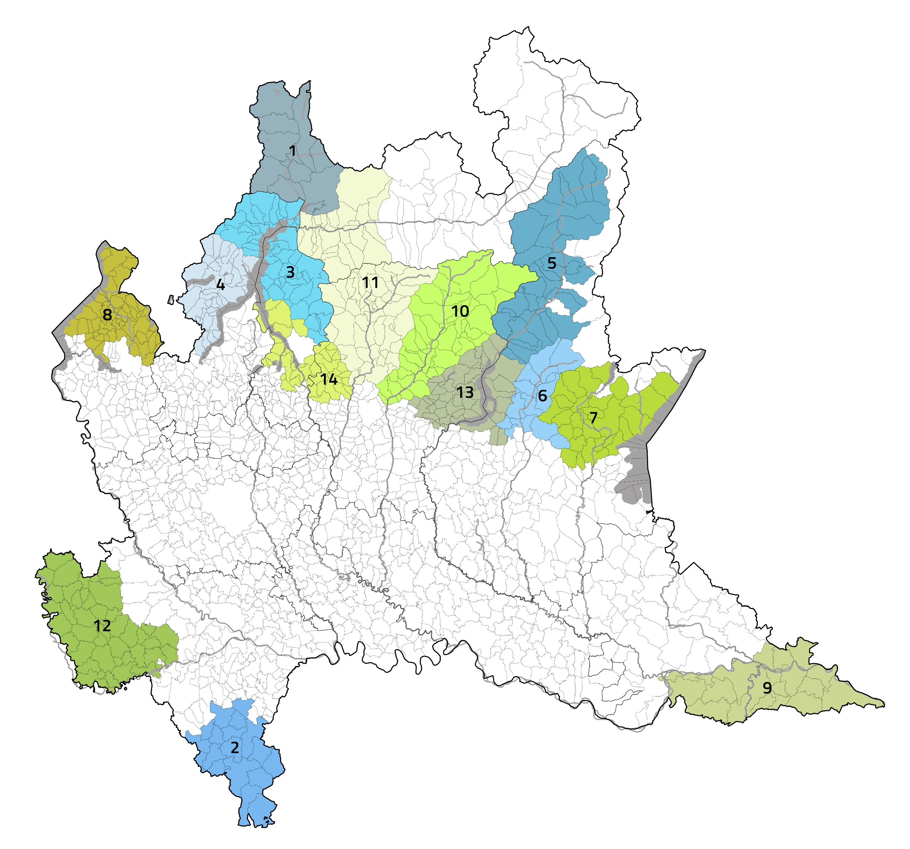
The Regional Strategy for Inner Areas: «Counter-Exodus Agenda»
1
Valchiavenna
2
Oltrepò Pavese
3
Alto Lago di Como e Valli del Lario
National
inner areas
4
Lario Intelvese e Valli Lario Ceresio
5
Val Camonica
6
Val Trompia
7
Val Sabbia – Alto Garda
8
Piambello Verbano
9
Oltrepò Mantovano
10
Val Seriana e Valle di Scalve
Regional
inner areas
11
Valle Brembana e Valtellina di Morbegno
12
Lomellina
13
Laghi Bergamaschi – Sebino Bresciano
14
Lario Orientale – Valle S. Martino e Valle Imagna
Matteo Bianchi – ANCI Lombardia

Slide 6
2
Inner areas and ANCI Lombardia:
a strategy for local development
Matteo Bianchi – ANCI Lombardia
16 November 2023

Slide 7
Inner areas and ANCI Lombardia:
a strategy for local development
THE COUNTER-EXODUS AGENDA FIRST STEPS
RESEARCH BY POLIS
«TERRITORIAL FRAGILITY» INDEX
COUNTER-EXODUS AGENDA
DGR XI/5587
23/11/2021
POLITECNICO OF MILANO
TERRITORIAL PORTRAYS
STRATEGIC AGENDAS
SUPPORT TO THE DEFINITION PROCESS OF THE STRATEGIES
ANCI LOMBARDIA
2021
2022
2023
2027
Matteo Bianchi – ANCI Lombardia

Slide 8
The support of ANCI Lombardia to the Inner Areas
ANCI Lombardia will carry out activities to support the 14 identified areas in collaboration with Region Lombardia in the implementation of the Counter-Exodus Agenda.
In the first phase ANCI Lombardia will support the 14 areas in the definition of local Strategies
Once defined, ANCI Lombardia will support the area throughout the implementation phase both through direct technical assistance and capacity building activities.
Three phases of activities:
1. Definition of local strategies
2. Implementation of local projects
3. Monitoring and reporting
Matteo Bianchi – ANCI Lombardia

Slide 9
3
Inner areas as a laboratory for local governance
Matteo Bianchi – ANCI Lombardia
16 November 2023

Slide 10
Inner areas as a laboratory for local governance
The 488 municipalities involved in the National Strategy are mostly small depopulated areas with structural deficits that often result into the lack of essential services (education, health and mobility).
The involvement of a Regional body - such as ANCI Lombardia - can guarantee the provision of skills and knowledge to support the local administrations in the implementation phase of the strategy.
For each area, the Lombardy Region has identified supra-local bodies as reference entities. Each body enables the definition and implementation of the local development strategy in their area.
The most common supra-local entity is the Mountain community. In non-mountainous areas two different form of upra-local entities have been identified:
> Consortium of the Oltrepò Mantovano
> LAG (Local Action Group) Risorse Lomellina.
Matteo Bianchi – ANCI Lombardia

Slide 11
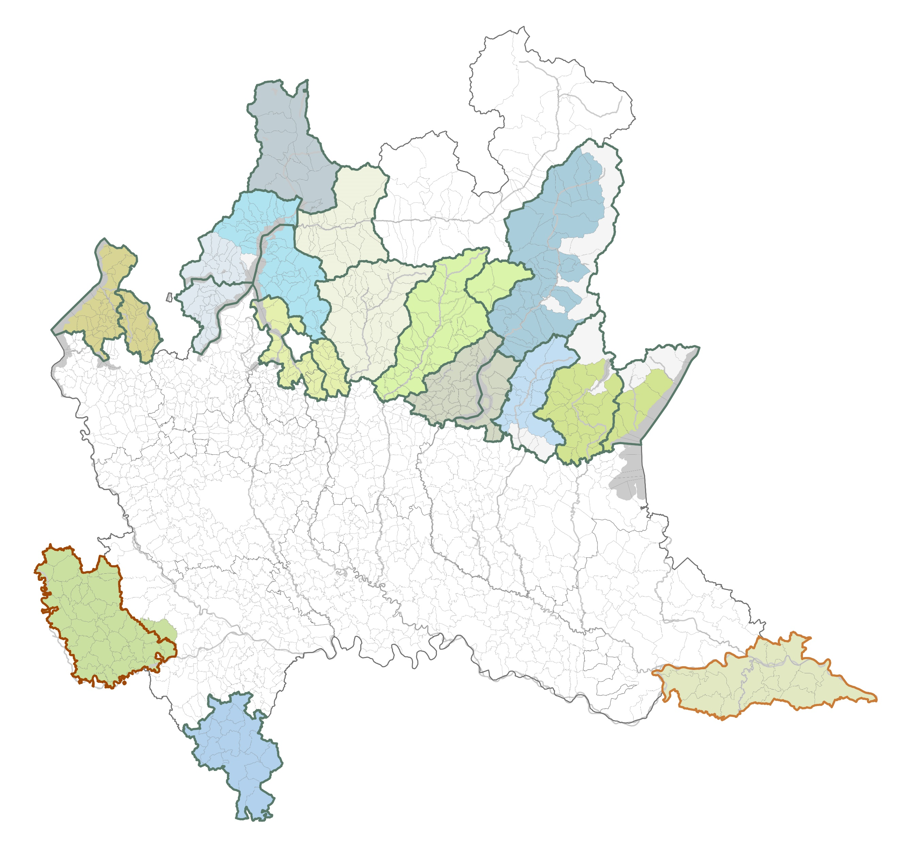
Italian experience of Inner Areas in Lombardia Region
A
Mountain Community Valli del Verbano (VA)
B
Mountain Community Piambello (VA)
C
Mountain Community Lario Intelvese (CO)
E
D
Mountain Community Valli del Lario e del Ceresio (CO)
I
E
Mountain Community Valchiavenna (SO)
D
M
F
Mountain Community Valsassina Valvarrone Val d’Esino e Riviera (LC)
F
L
G
Mountain Community Lario Orientale Valle S. Martino (LC e BG)
A
B
C
J
K
H
Mountain Community Valle Imagna (BG)
G
H
N
O
P
R
I
Mountain Community Valtellina di Morbegno (SO)
Q
J
Mountain Community Valle Brembana (BG)
K
Mountain Community Valle Seriana (BG)
L
Mountain Community Val di Scalve (BG)
M
Mountain Community della Vallecamonica (BS)
N
Mountain Community dei Laghi Bergamaschi (BG)
T
O
Mountain Community del Sebino Bresciano (BS)
U
P
Mountain Community della Valle Trompia (BS)
Q
Mountain Community della Valle Sabbia (BS)
S
R
Mountain Community Alto Garda Bresciano (BS)
S
Mountain Community dell’Oltrepò Pavese (PV)
T
LAG Lomellina (PV)
U
Consortium Oltrepò Mantovano (MN)
Matteo Bianchi – ANCI Lombardia

Slide 12
The Mountain communities
Mountain communities are unions of municipalities, local authorities established between mountainous and partially mountainous municipalities, that may belong to different provinces.
Mountain communities are responsible for the development of their area. They exercise their own functions, conferred functions and some municipal functions.
They perform functions such as the promotion and enhancement of the area, as well as the management of special interventions.
IN NUMBERS:
23 Mountain communities in Lombardy
19 Mountain communities in inner areas
Norms:
- art. 27, d.lgs. 18 august 2000, n. 267 (TUEL)
- art. 1., l.r. 27 june 2008, n. 19
Matteo Bianchi – ANCI Lombardia

Slide 13
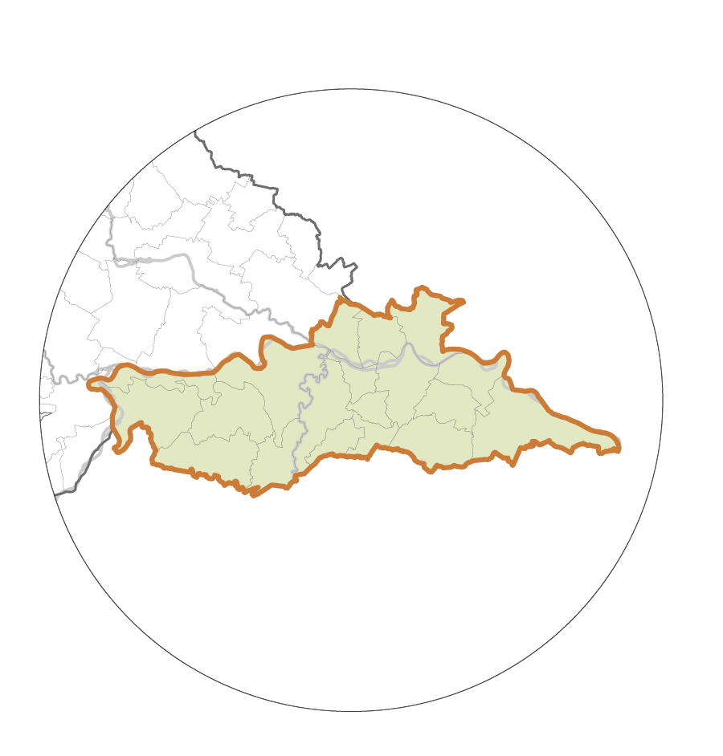
INNER AREA: Oltrepò Mantovano
The Lombardy Region has identified the local Consortium as the reference body for the 'Oltrepò Mantovano’ Inner Area.
This is a body established for the associated management of one or more municipalities functions.
The Consorzio Oltrepò Mantovano (COM) performs the functions such as: tender procedures for the purchase of goods or services for the municipalities, writing proposals and projects for the area, promoting sustainable development and tourism.
Matteo Bianchi – ANCI Lombardia

Slide 14
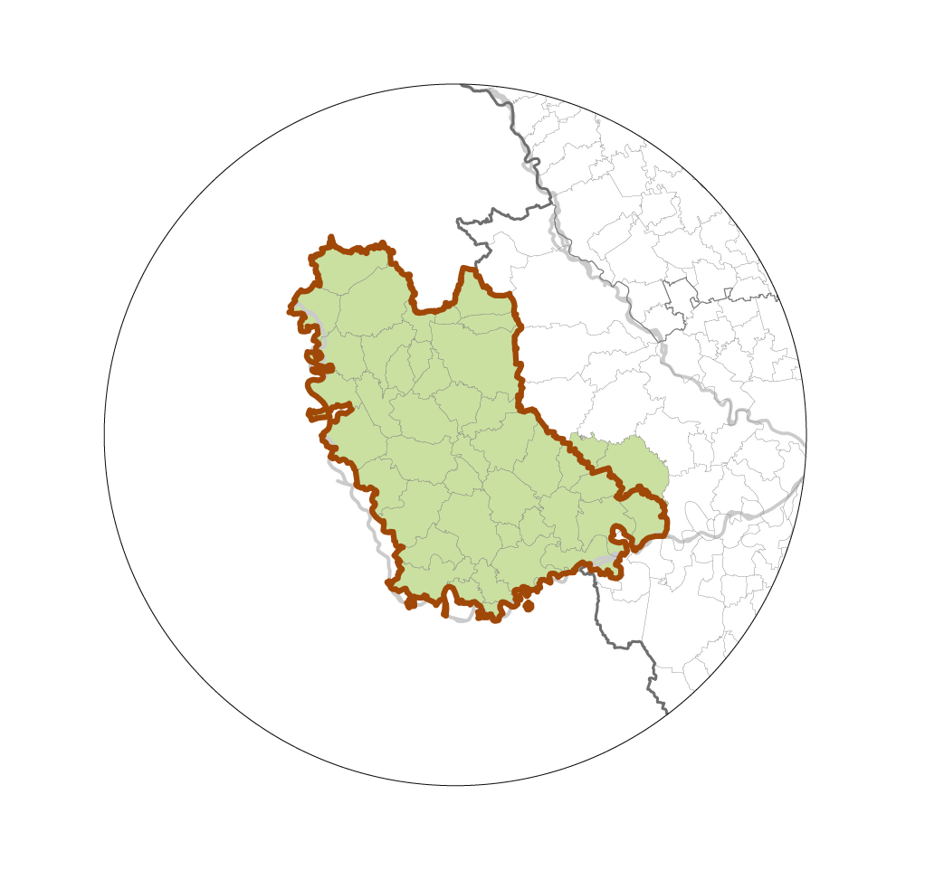
INNER AREA: Lomellina
There is no supra-local body in the Lomellina area that performs functions similar to those of a Mountain communities or the Consortium.
Therefore, the Lombardy Region has identified the LAG “Risorse Lomellina” as the reference body for this area.
LAGs are bodies made up of public and private stakeholders who work toeghther on strategic decisions for local development, the enhancement and promotion of the territory.

Slide 15
Assistance instruments for Local Authorities
Both for the Lombardy Region and ANCI Lombardia, the strategy of internal areas is a laboratory for the development of actions and forms of governance to support local authorities.
Forms of governance are addressed at the regional level with the aim of fostering a more effective and efficient use of the municipalities’ resources.
Two examples:
Competence Centres, a tool to activate local authorities to develop skills, services of citenzens.
SEAV (Servizio Europa d'Area Vasta) project dedicated to the support and development of collaborations between municipalities for European planning.
Matteo Bianchi – ANCI Lombardia

Slide 16
Thank you!
Please visit us at www.espon.eu

